Slide 1
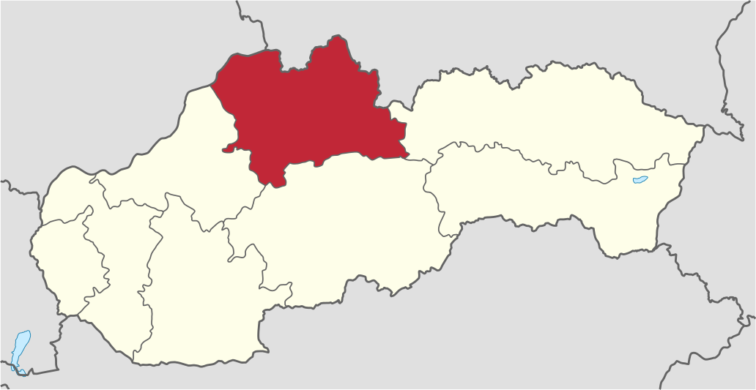
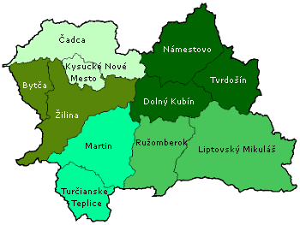
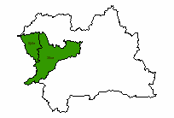
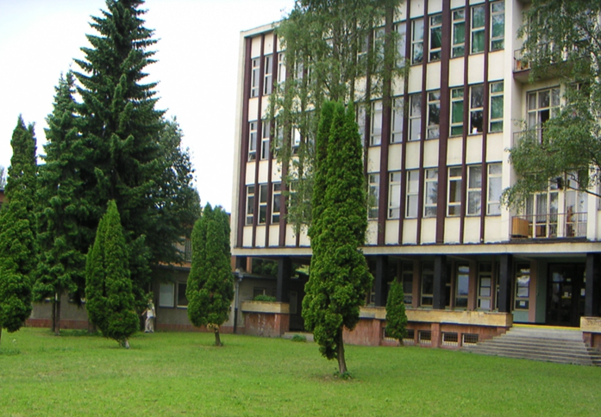
The Secondary School of Agriculture & Services in the Country
ŽILINA Region
Horné Považie
Predmestská 82, Žilina
Žilina Region
ŽILINA

Slide 2
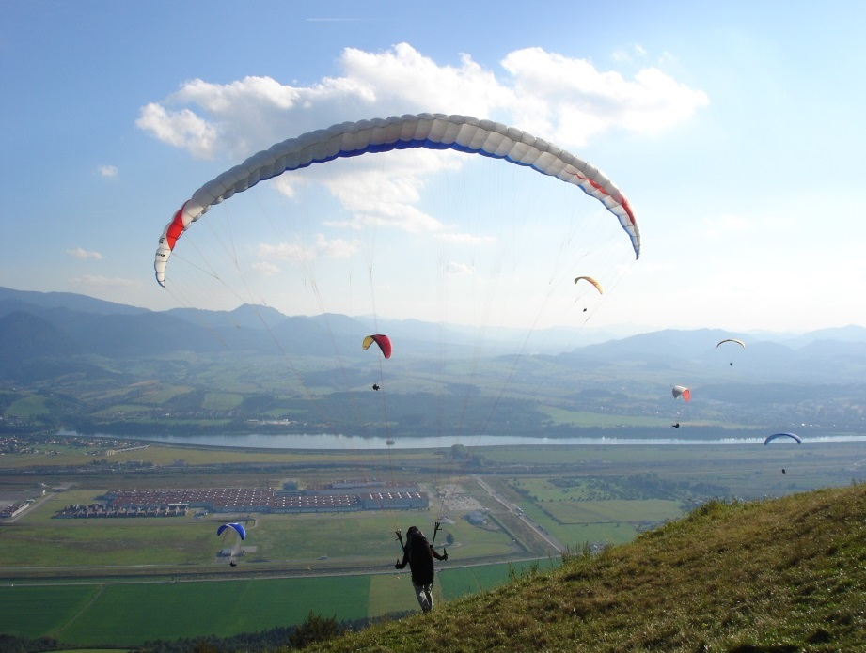
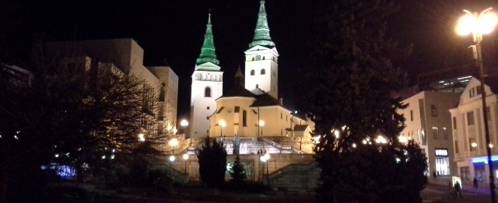
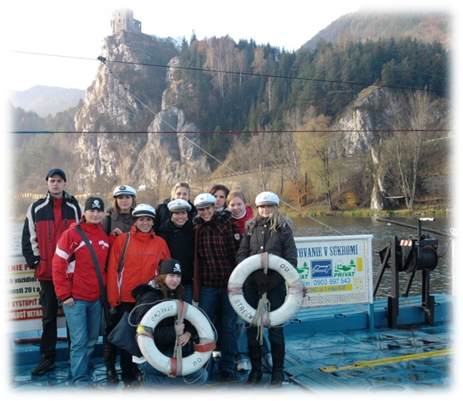
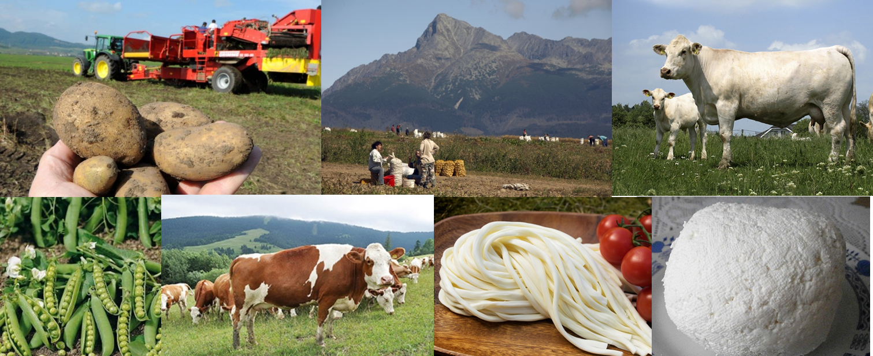
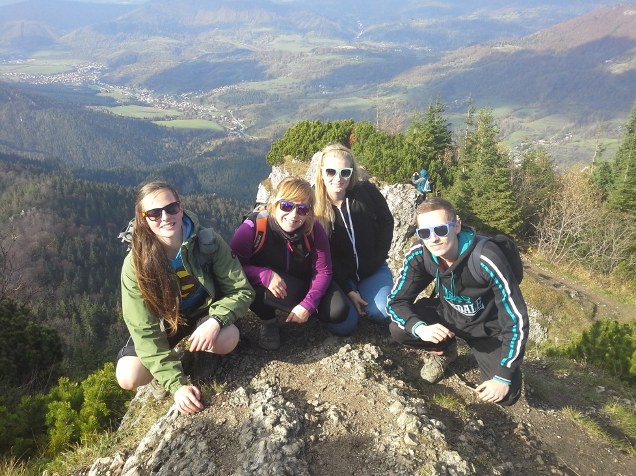
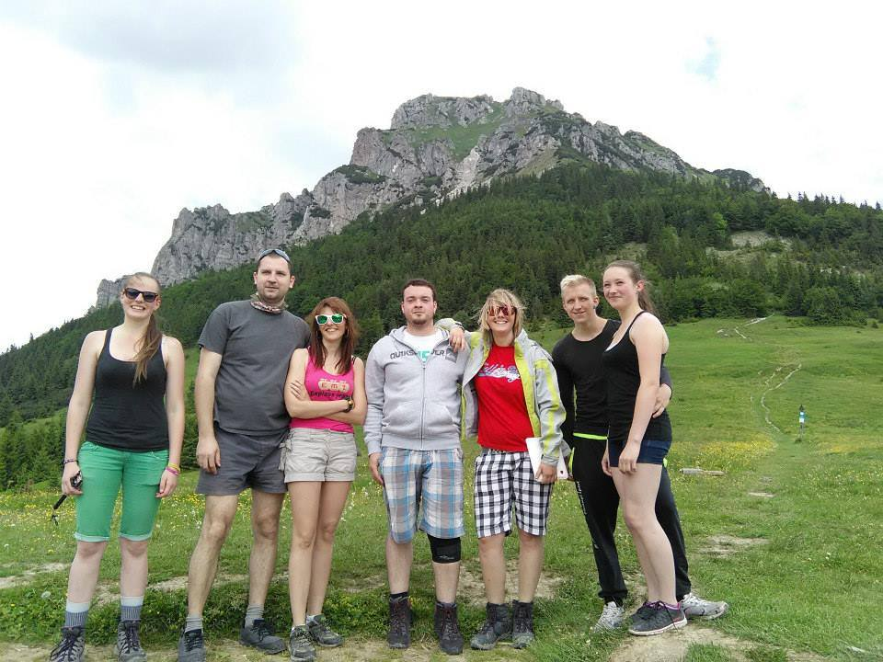
HORNÉ POVAŽIE Region
Strečno castle
Žilina
Stránik
Terchová Valley
Terchová
NP of Low Fatras
Rozsutec

Slide 3
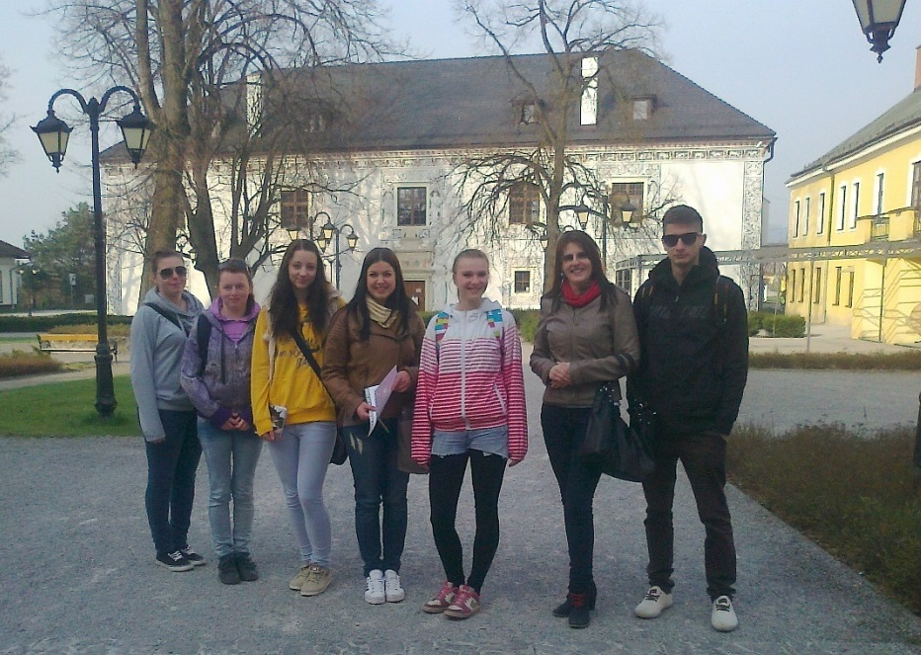
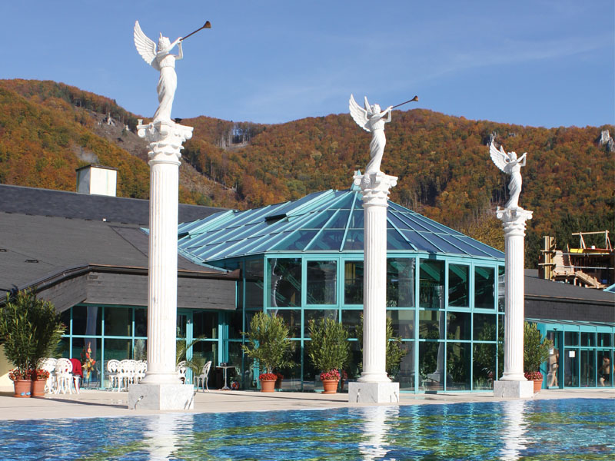
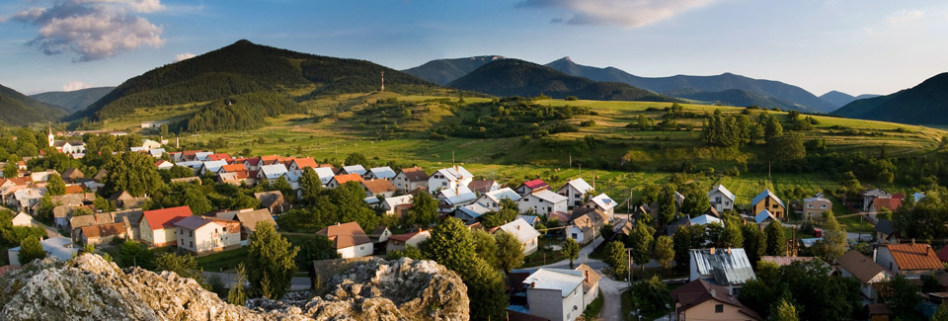
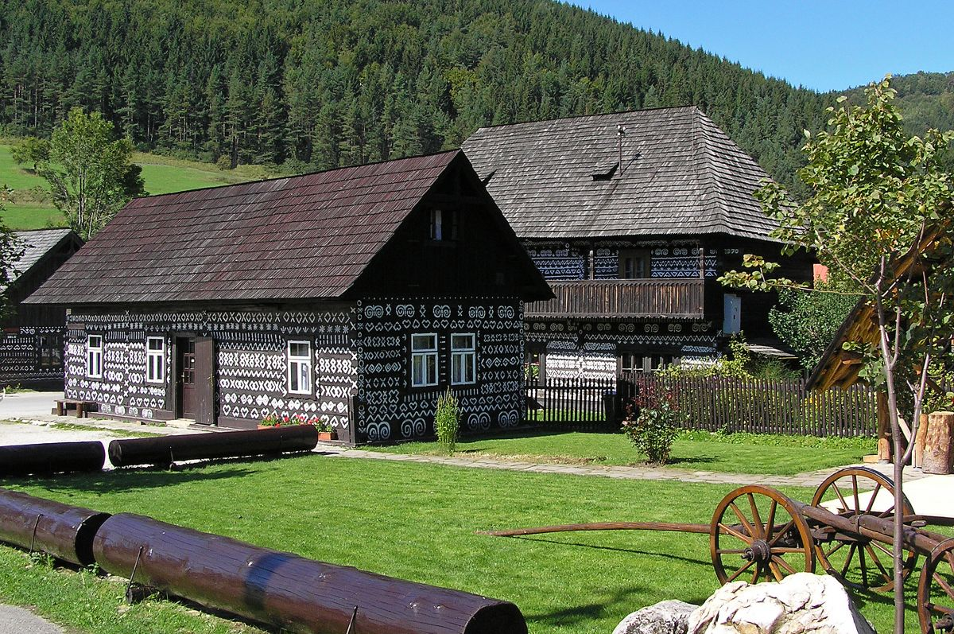
HORNÉ POVAŽIE Region
Bytča Basin
Súľov rocks
Bytča
Rajec Valley
Lietava castle
Spa
Čičmany

Slide 4
The Structure of Land Resources
 | Slovakia | Žilina Region
Total area (ac) | 4 903 613 | 680 866
Farmland (ac) | 2 410 812 | 244 896
Arable land (ac) | 1 415 653 | 60 896
Meadows and Pastures (ac) | 874 224 | 177 552

Slide 5
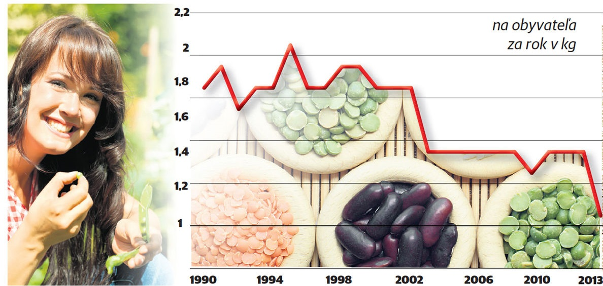
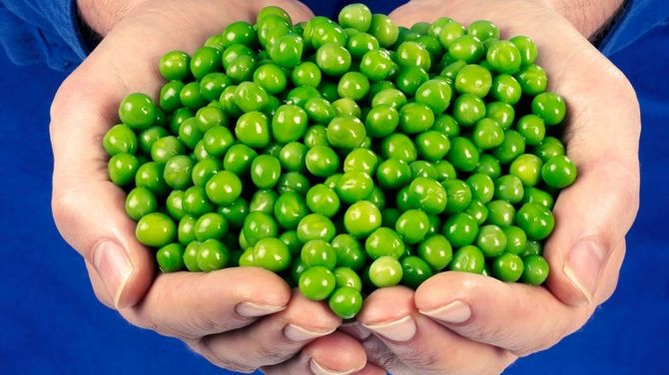
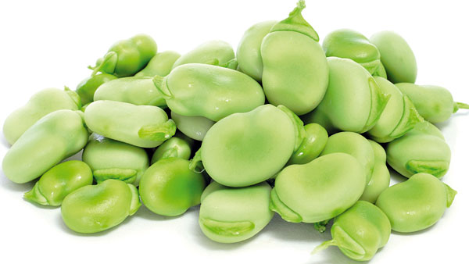
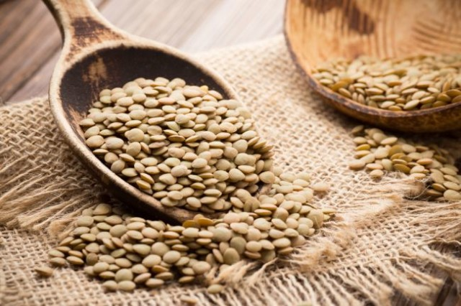
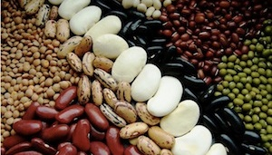
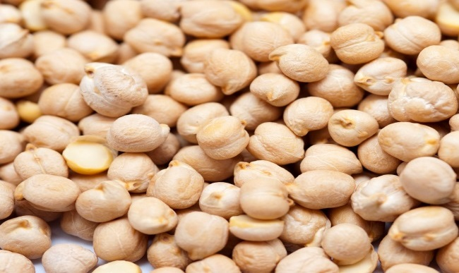
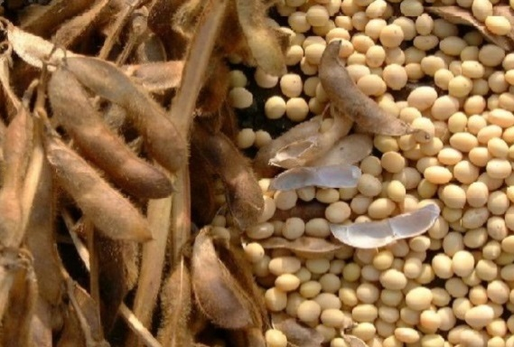
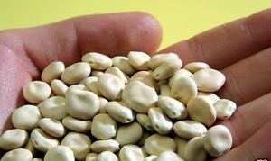
Legumes and their importance
Family Fabaceae /Leguminosae /
Annual consumption of legumes in Slovakia per capita in kg
Pisum – Pisum sativum
Vicia – Vicia sativa
Lens – Lens culinaris
Phaseolus – Phaseolus vulgaris
Cicer- Cicer arietinum
Glycine – Glycine max
The source of proteins – 19 - 45%
The source of minerals – K, Ca, Mg, Fe, Zn
The source of vitamins – group B
The production of oil /soy/
Prevention of cardio – vascular diseases
Adjusting digestion and cholesterol
Prevention of lifestyle diseases
Lupinus – Lupinus albus

Slide 6
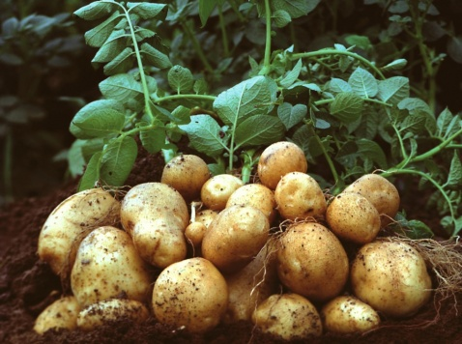
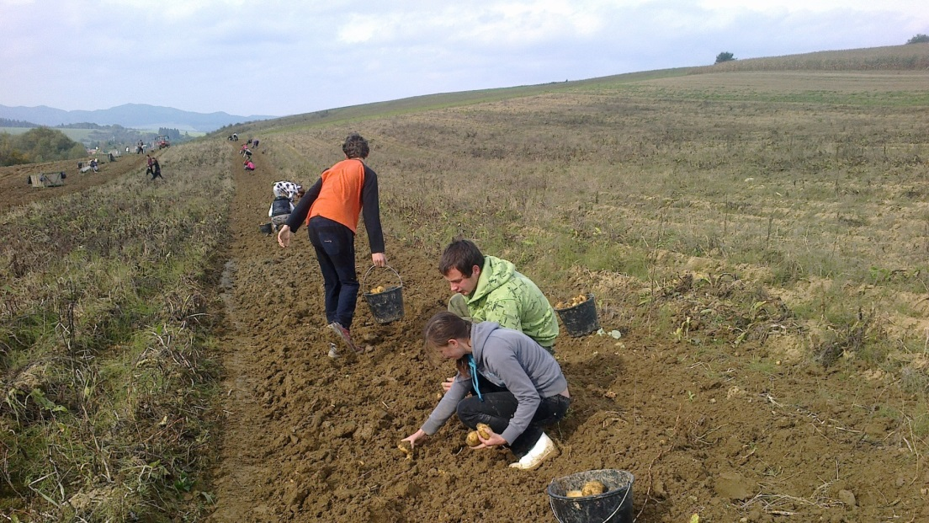
Potatoes and their importance
Solanum tuberosum
They contain:
water - 75%,
starch - 17%,
proteins - 2%,
vitamins A, B1, B2, B6, C, H, K.
Fat – free food
A rich source of potato starch
A large amount of vitamins - C, B1, B2, B3, B6
A lot of minerals – Mg, K
A high content of fiber
Indicator | 2009 | 2010 | 2011 | 2012 | 2013 | 2014
Harvested area (ha) | 1 051 | 1 092 | 939 | 789 | 1 410 | 910
Hectare yield (t/ha) | 18,03 | 14,64 | 16,72 | 17,21 | 19,25 | 17,70
Production (t) | 18 951 | 15 987 | 15 695 | 13 579 | 27 146 | 16 107

Slide 7
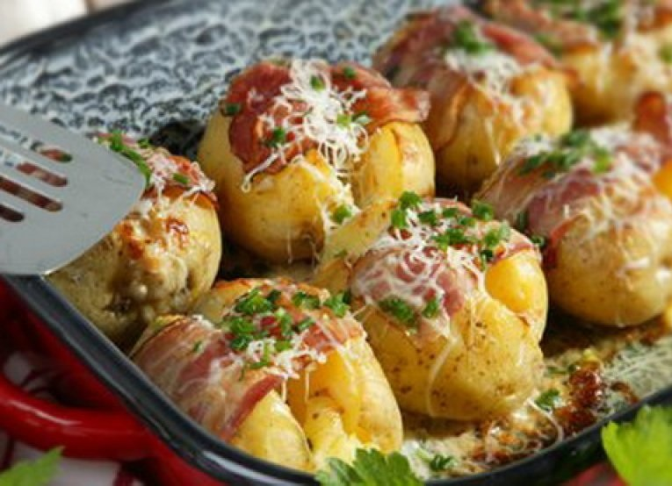
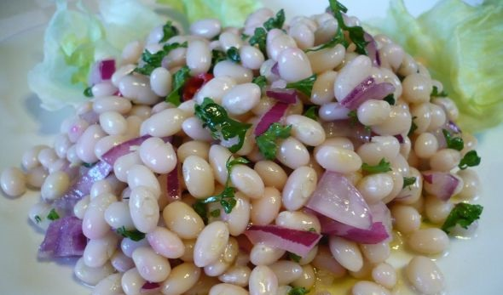
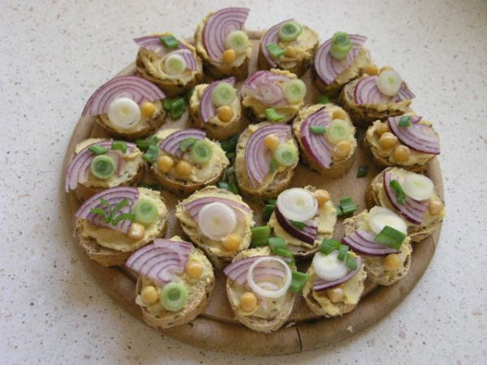
GOOD APPETITE
The salad of white beans
Chickpea spread
We need: ½ package of chickpea, bay leaves (2 pcs), a bigger onion, 3-4 cloves of garlic , ½ glass of fat-free mayonnaise, olive oil, salt, parsley leaves, the juice of 1 lemon, 2 tbsp of mustard, spreadable butter.
Baked stuffed potatoes
We need: 25 dkg of cooked beans, 1 onion, 1 pickle, 1 tbsp of oil, 15 dkg of hard cheese, black pepper, parsley leaves, lemon juice, salt.
We need: 6 pcs of potatoes, 1pcs of onion, 150 ml of sour cream, 200 g of cheese eidam block, 100 g bacon, 1 cup of olive oil, a hadful of chopped chives, 2 cloves of garlic, ground cumin, black pepper, salt to taste.
The procedure: Cut tender boiled potatoes in their jackets on one side and press while hot to open them slightly. Filling: Fry the onion lightly in oil, then mix with sour cream, a pressed garlic, salt, ground cumin, and grated cheese in a bowl. Season with ground black pepper and mix well. Stuff the cavity of potatoes with the filling, sprinkle with cheese and cover with slices of bacon. Bake stuffed potatoes for about 10 min in an oven at 200 °C. Garnish with chives.
The procedure: Soak chickpea in salt water for 12 hours a day ahead, the following day pour off the water and cook with 2 pcs of bay leaves. Drain and allow to cool. Mix all of the above mentioned ingredients in a blender – start with liquid ones and add gradually the handful of chickpeas. Leave some chickpeas for decoration. Stir to a smooth spread in a blender. Feel free to add the juice of the whole lemon and two tablespoons of mustard. It tastes great with a red onion ,and of course, with other fresh vegetables as well.
The procedure: Add the finely chopped onion, a pickle and parsley leaves to lukewarm strained beans. Season with salt, pepper or with lemon juice. Drizzle with oil and sprinkle with grated cheese before serving.

Slide 8
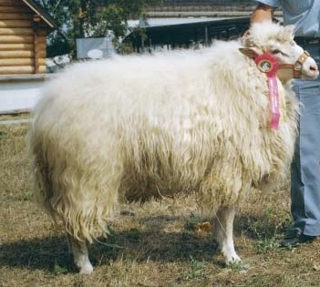
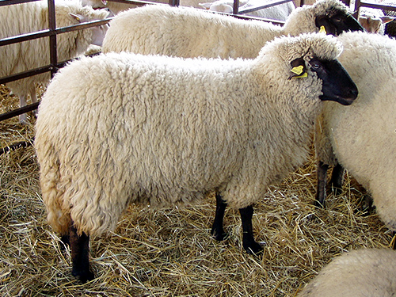
Sheep breeding
The products made of sheep milk
Bred valaška
Cigája
The most repesented breed
Product performance: 107 l of milk, 7,5% of fat
One of the oldest black-headed breed
Product performance : 113 l of milk, 7,13% of fat
Sheep Cheese
Žinčica
A drink made of sheep milk
Bryndza
Sheep cheese
Oštiepok
A smoked sheep cheese
Parenica
„Steamed“ cheese
Sheep Yogurt
The cakes made of sheep cheese

Slide 9
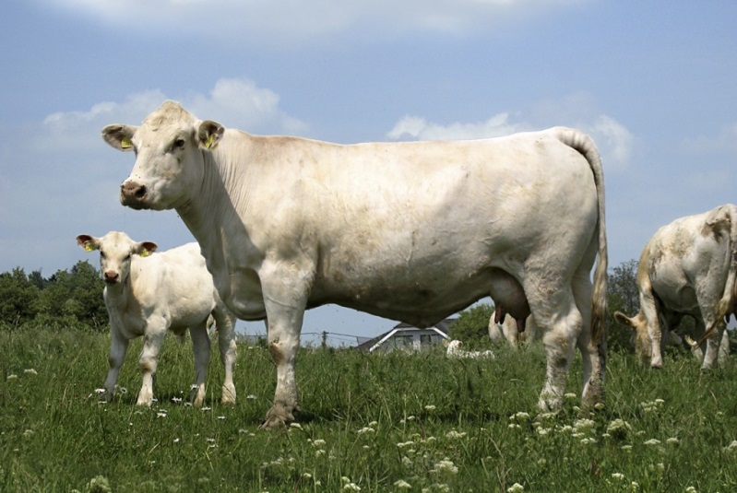
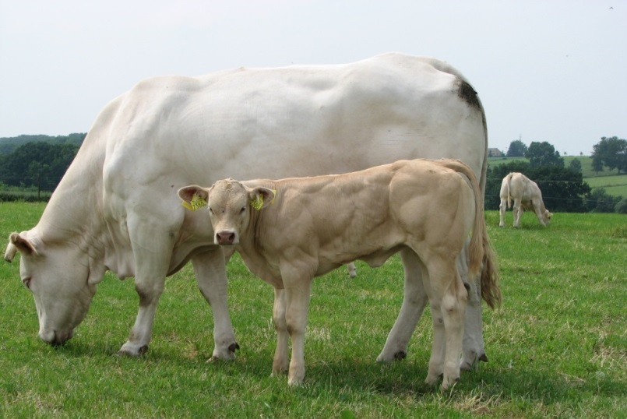
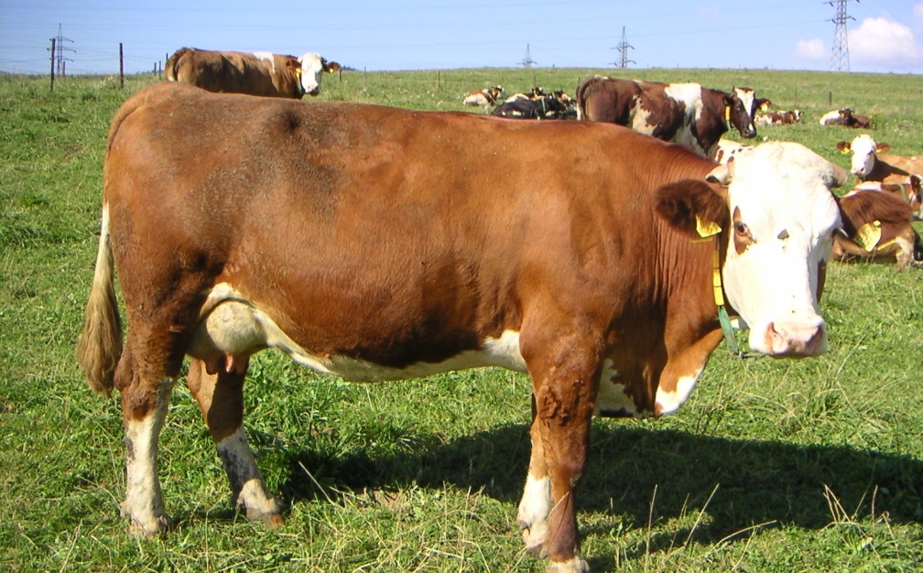
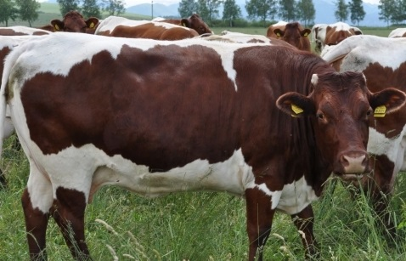
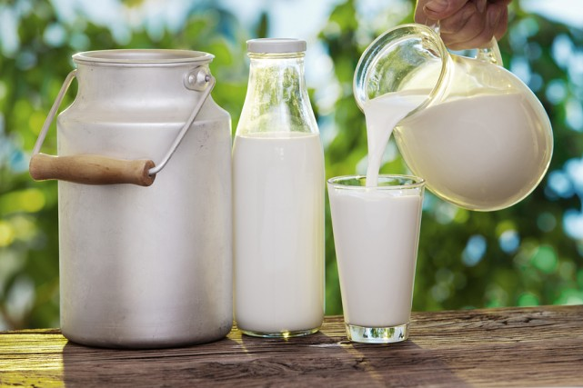
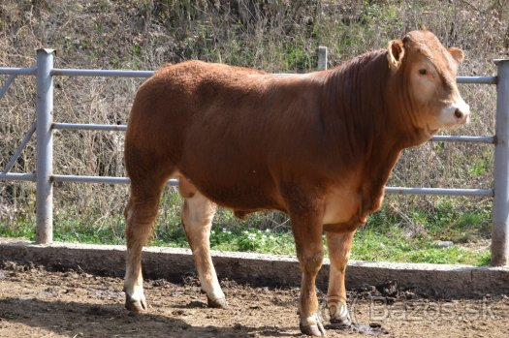
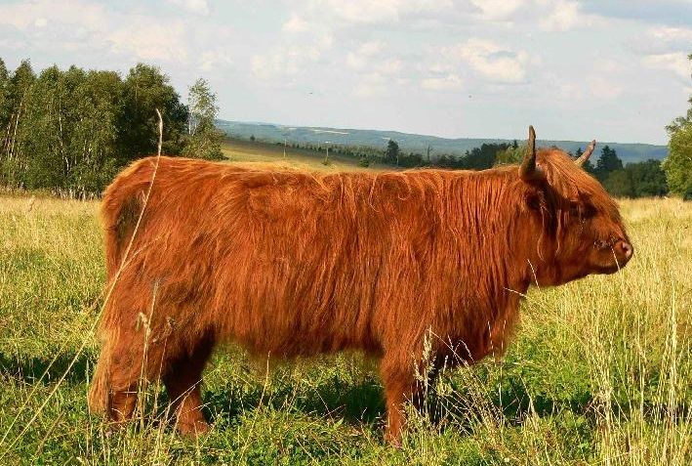
Beef cattle breeding
Meat breeds
Combined breeds
Charolais
- carcass yield 68 %
Blonde D´Aquitaine
- carcass yield 67 %
The products made of cow milk
Slovenský strakatý
Slovenský pinzgauský
The liveweight of a cow: 650 kg, of a bull: 1100 kg
Milk production: 4 500 – 5500 kg
Fat content: over 4 %
The liveweight of a cow: 550 kg, of a bull: 800 – 900 kg
Milk production: 3 000 - 4 000 kg
Fat content: over 4 %
Limousine
- carcass yield 63 %
Scottish Highland
- carcass yield 61 %
Product performance (milk): SVK – 7 500 kg, Žilina Region – 6 551 kg, The District of Žilina – 5 838 kg
Curd
„Korbáčiky“
Butter
Yogurt

Slide 10
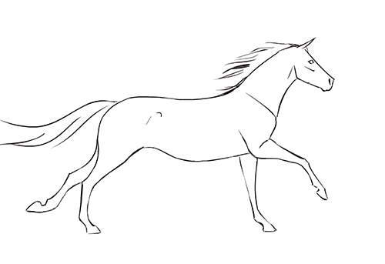
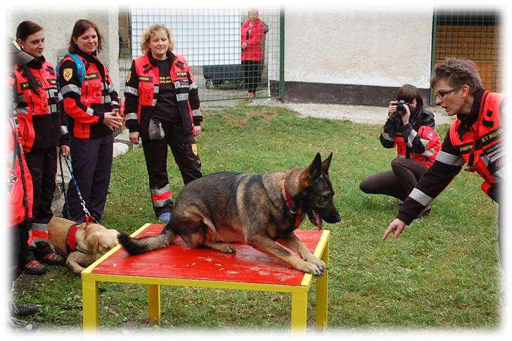
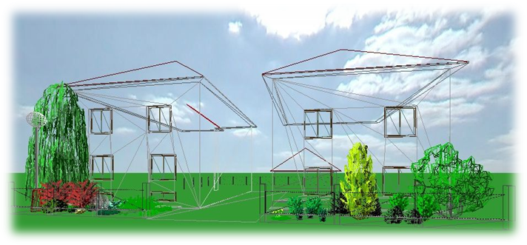
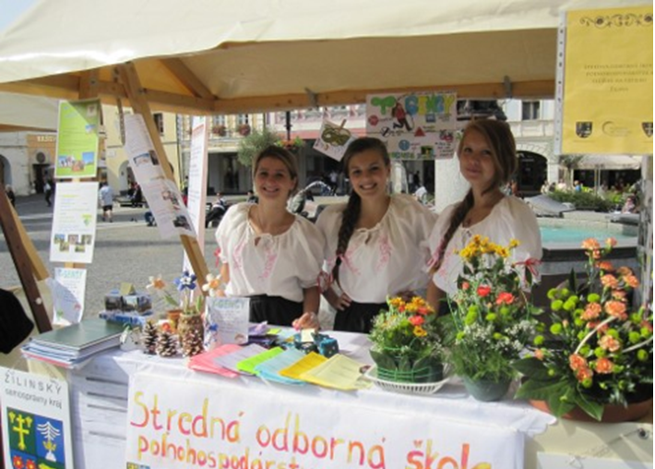
THE Secondary school of agriculture & services In THE country

Slide 11
BRANCHES of STUDY in the school year 2016/17
GARDENCRAFT– study focus:
- LANDSCAPING AND GARDENING FORMATION
AGROBUSINESS – study focuses:
- Cynology
- AGRICULTURal MANAGEMENT
REGIONAL TOURISTS MANAGEMENT
veterinary medIcine– study focus: - SANITARY AND LABORATORY SERVICES

Slide 12
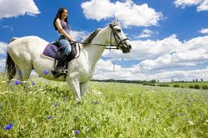
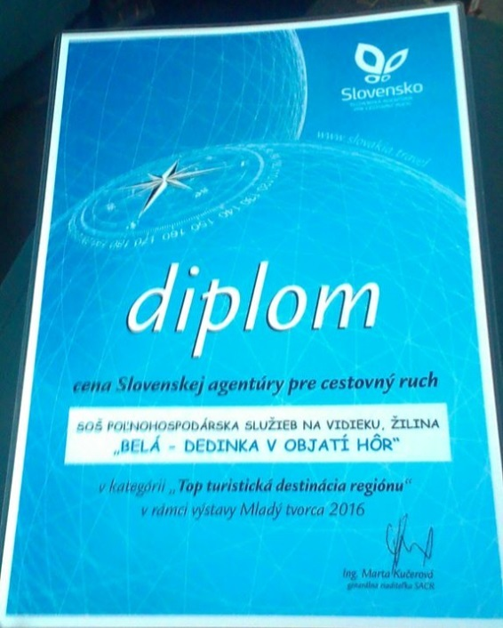
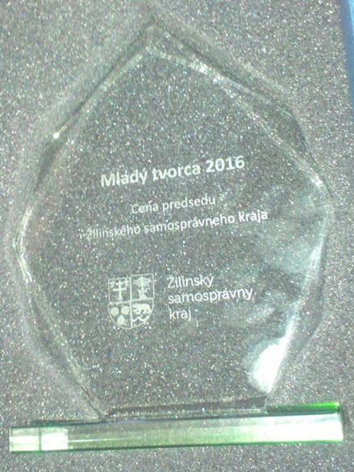
2015 – 2016 OVERVIEW
The only school in the Region of Žilina offering the full secondary education in economics, horticulture and agriculture.
Awards
The best secondary vocational school according to employers in Žilina Region in 2014/2015 and the second best in 2015/2016
The Price of Slovak Tourist Board
2016
The Price of the Žilina Self
– Governing Region 2016
High specialized study – postsecondary study Country tourism
Completed projects
EU project: The Modern Learning Centre of Cynology
Project: Digischool
International certificate IES, rating BB
The certificate of solvency
A tour guide course – the certificate of a tourist guide
Driving school

Slide 13
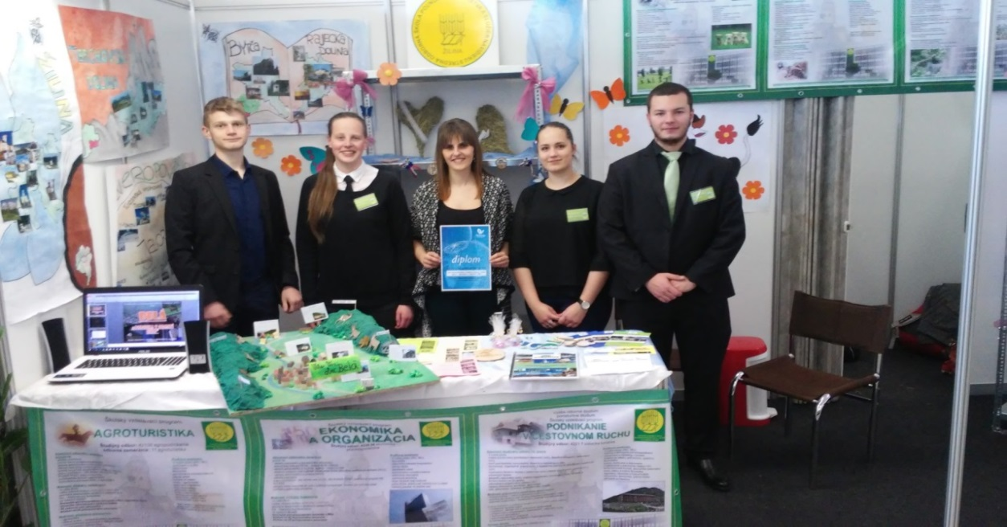
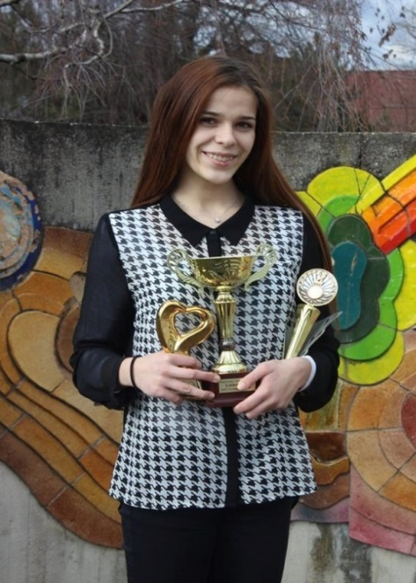
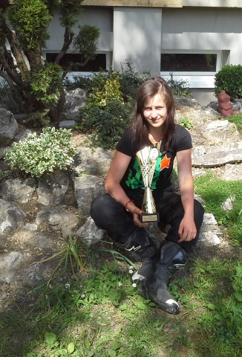
The achievements of our students 2015 – 2016
JA company SEPORtour - the best JA travel agency 2016
JA mascot SEPORtour 2015
Young Eco-farmer 2016 – the 1st place
Flower arranging competitions (Flora, Easter in Pruské, Košice) – the 1st places
Top agri girl 2015 – the 2nd place
Top agri boy 2016 – the 3rd place ...

Slide 14
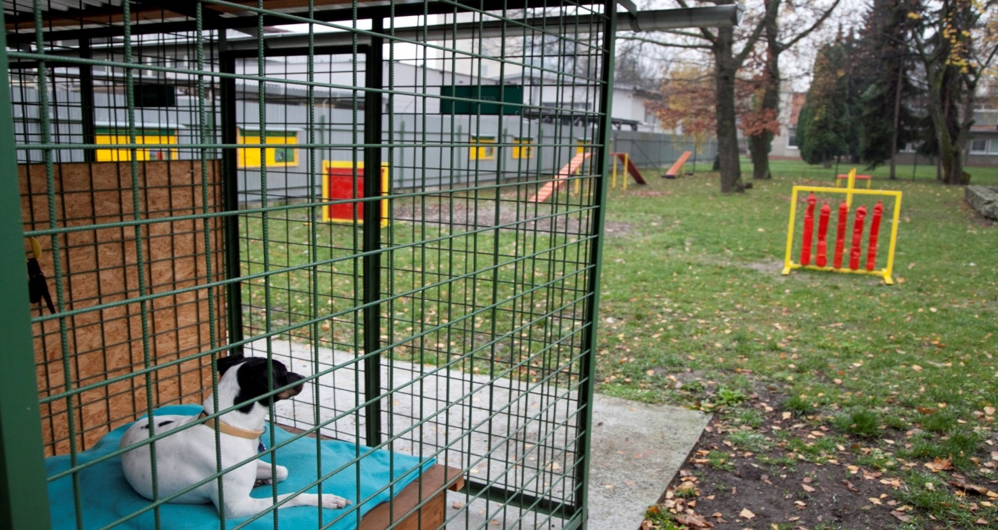
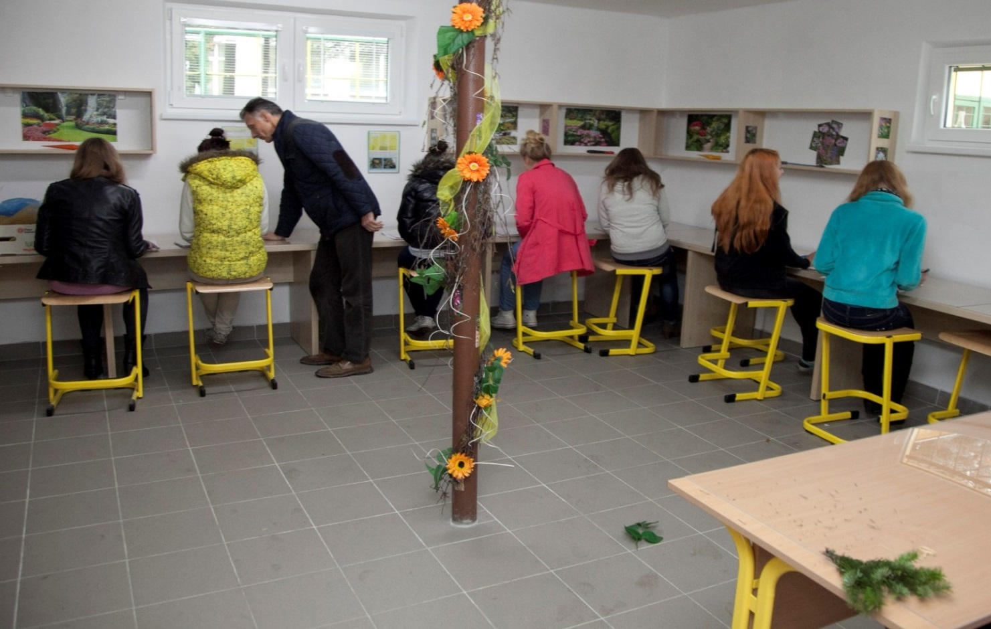
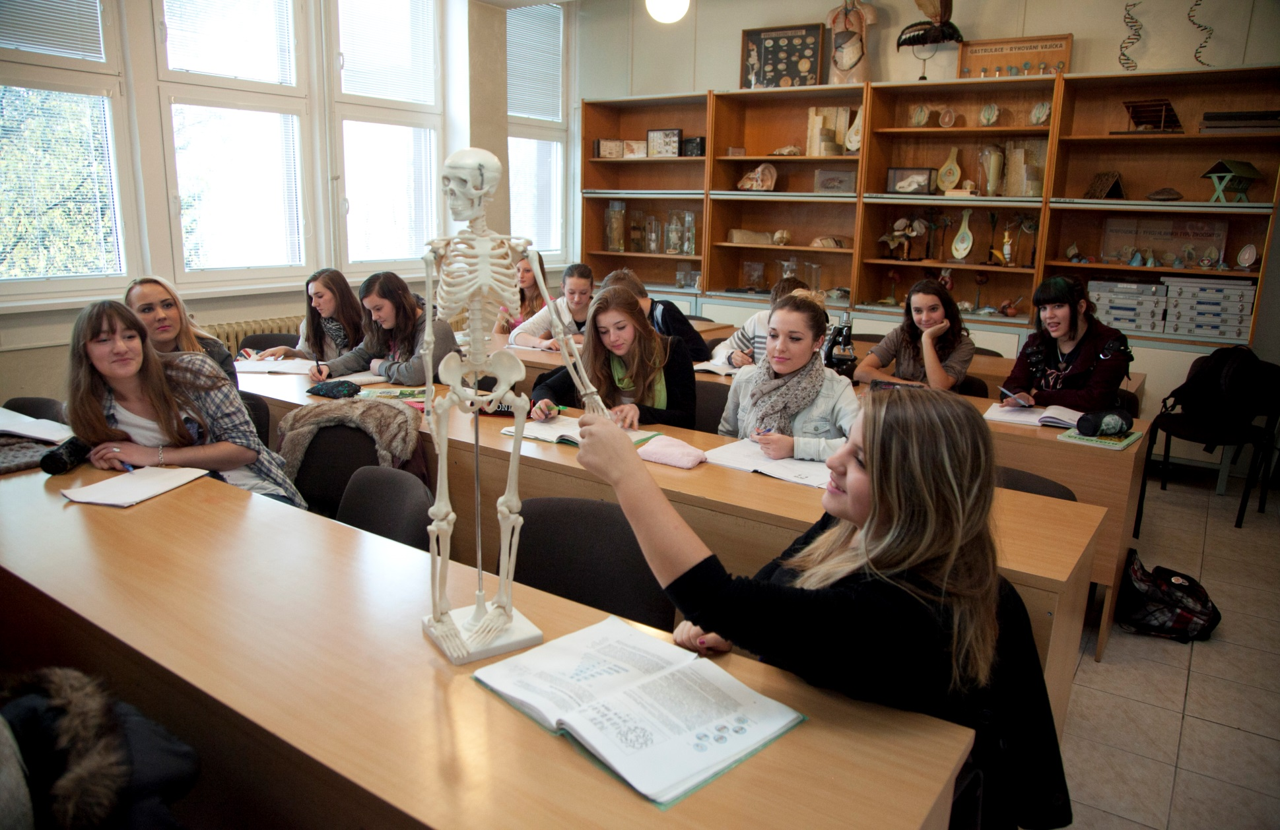
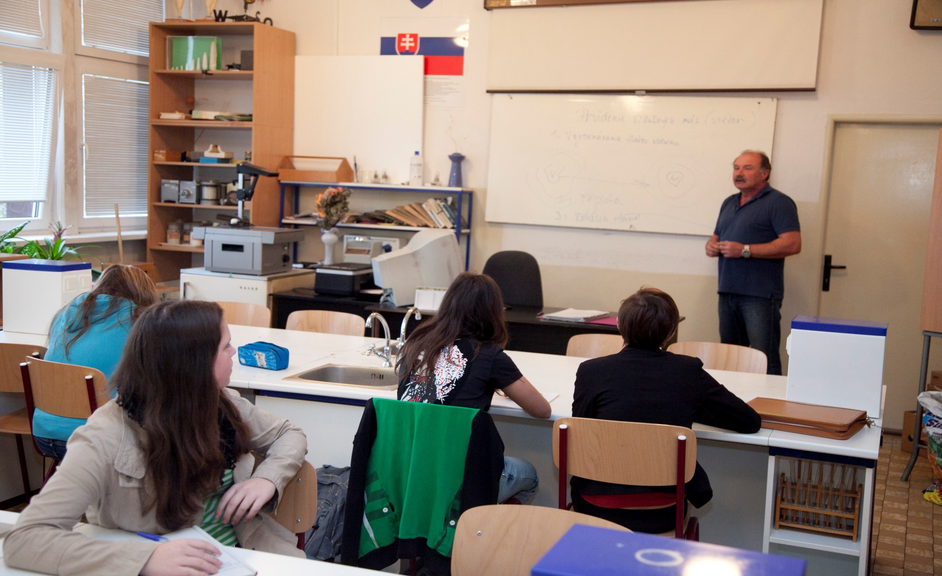
Modern learning classrooms and laboratories
The Centre of Vocational Education and Training in Cynology for Žilina Region
The School Centre of Garden Architecture

Slide 15
Some of the traditional school events
The Canine Workshops
The Exhibition of Spring Beauty
Hričov pastorale
Christmas party- traditional crafts
The Exhibition of Dogs
Quadrille
The Exhibition of Fruit, Vegetables and Flowers
Budatínsky rínok / market and Rural Day
The 12th year of a School dance ball

Slide 16
CONTACT INFORMATION
Predmestská 82, 010 01 Žilina 1 Telephone number: 041/723 23 65
Fax: 041/723 27 07 Telephone number of the
headteacher: 041/700 25 74
E-mail : sekretariat@spospredza.edu.sk riaditel@spospredza.edu.sk
www.spospredza.edu.sk

